Slide 1
TAFC
August 2011
Notes:
© 2006 Capgemini - All rights reserved
© 2006 Capgemini - All rights reserved

Slide 2
Objectives
After completing this learning unit, you will be able to:
Explain what is jBASE
Analyze a simple T24 Architecture
Analyze jBASE directory structure
State the purpose of the .profile/remote.cmd file
Analyze jBASE environment variables
JBCRELEASEDIR, JBCPORTNO, JBCGLOBALDIR, PATH, LIBPATH, JBCSPOOLERDIR, JEDIFILENAME_MD, JBCLISTFILE, JBCEMULATE, JBASE_ERRMSG_DIVIDE_ZERO, JBASE_ERRMSG_ZERO_USED, JBASE_ERRMSG_NON_NUMERIC
Slide <number>
Notes:
After completing this learning unit, you will be able to:
Explain what is jBASE
Analyze a simple T24 Architecture
Analyze jBASE directory structure
State the purpose of the .profile/remote.cmd file
Analyze jBASE environment variables
JBCRELEASEDIR, JBCPORTNO, JBCGLOBALDIR, PATH, LIBPATH, JBCSPOOLERDIR, JEDIFILENAME_MD, JBCLISTFILE, JBCEMULATE, JBASE_ERRMSG_DIVIDE_ZERO, JBASE_ERRMSG_ZERO_USED, JBASE_ERRMSG_NON_NUMERIC
JBS1. Introduction to jBASE Database-R11.01

Slide 3
TAFC
From Release R9, jBase releases used by Temenos are known as TAFC (Temenos Application Framework C)
Like any other database system, TAFC could be thought of having two sides to it – the database and the runtime
The term jBase is used with respect to the database and it’s file system.
TAFC is used refer to the runtime
Notes:
From Release R9, jBase releases used by Temenos are known as TAFC (Temenos Application Framework C)
Like any other database system, TAFC could be thought of having two sides to it – the database and the runtime
The term jBase is used with respect to the database and it’s file system.
TAFC is used refer to the runtime
JBS1. Introduction to jBASE Database-R11.01

Slide 4
jBASE
jBASE Database
  Post Relational Database Management System
    Supports multi value and sub value (Non fixed length fields)
  Development environment
    Create ,compile and execute programs
  Extension of the operating system
    jsh (jshell – Can execute most of the operating system commands)
  Open database – Can communicate to other databases
    Direct Connect Drivers
  Uses the ‘C’ compiler to compile code
  T24 uses jBASE Database to store data
Notes:
jBASE Database is
1.1 A Post Relational Database Management System. It supports multi value and sub value, they are Non fixed length fields.
1.2 A Development environment. It comes with a programming language called jBASE BASIC. jBASE can be used to create ,compile and execute programs
1.3 An extension of the operating system. The jsh(jshell) provided by jBASE can execute most of the operating system commands)
1.4 An Open database. It can communicate to other databases using Direct Connect Drivers
1.5 It Uses the ‘C’ compiler to compile code
1.6 T24 uses jBASE Database to store data. jBASE provides a run time environment (Like JRE in java). T24 resides on the jBASE Run Time Environment. The runtime enables T24 to communicate with the jBASE database
JBS1. Introduction to jBASE Database-R11.01

Slide 5
T24 Architecture – An Overview
User
4
T24 Application Server
T24 (Application)
3
TAFC
jBASE Database
2
Unix/Windows
(Operating System)
1
Notes:
What you see here is a simple T24 Architecture.
The first layer of the T24 Application Server is the operating system like UNIX, Windows etc.
jBASE is installed in the second layer, above the Operating System. When jBASE is installed, the database and the run time commonly referred to as TAFC, get installed together.
T24 is installed above jBASE. TAFC acts as a runtime for T24. TAFC helps T24 to communicate with the jBASE database
The User layer can either be a terminal emulation software, Globus Desktop or T24 Browser.
JBS1. Introduction to jBASE Database-R11.01

Slide 6

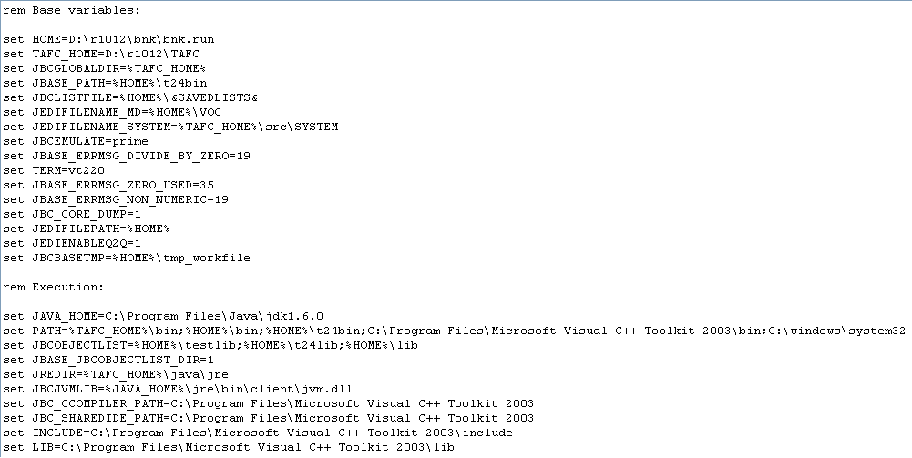
Logging Onto TAFC
Notes:
Logging Onto TAFC
Whenever a user wishes to log on to T24 running on TAFC, the steps would be logon to Windows by specifying a username and password. Once the Windows username and password are verified, the remote.cmd file (.pfofile in case it is a Unix server) under the home directory of the user is executed. It is in this remote.cmd file that TAFC environment is setup and the user is taken to T24.
For more details on this, refer documentation on ‘T24 directory structure and important files in T24’
JBS1. Introduction to jBASE Database-R11.01

Slide 7
TAFC Directory Structure
/jBASE<release number>
bin
config
lib
tmp
dev
jspooler
Notes:
TAFC has a directory structure similar to that of Unix.
bin : Contains all the binary executables that make up the TAFC system including the compilers.
Config: Contains various configuration files relating to the jPML daemon(discussed later in this section), the configuration file for the creation of library files(Discussed in the session ‘Infobasic Programming ‘) and other configuration files.
lib: Contains the library files that are required for the working of TAFC. This directory contains all the libraries required for linking and executing jBC-compiled routines. Shared or Dynamic libraries are also stored here. Library files stored here are similar to dynamic link libraries (.dll) files in Windows.
tmp: This is a general purpose temporary directory for runtime use.
jspooler: This is the spool directory of TAFC . It contains all the files that are required for spooling to work in TAFC . This directory is created as a part of the printer set up of TAFC and does not get installed when TAFC is installed. You should create this directory manually.
JBS1. Introduction to jBASE Database-R11.01

Slide 8
Workshop
Change to directory where TAFC has been installed and list the contents of the directories that you have just learnt
Notes:
Change to directory where TAFC has been installed and list the contents of the directories that you have just learnt
JBS1. Introduction to jBASE Database-R11.01

Slide 9
Logging on to jBASE
All users are assigned a port when they log on to the server
jBASE assigns port when user logs in
Port numbers are picked up from a file called “port0-499” found under the “$JBCRELEASEDIR/proc” directory
Set the environment variable JBCPORTNO in the .profile to a certain value if you always want to use a particular port number
  JBCPORTNO = 1000-1005
  JBCPORTNO = 1000,1001,1002,1003,1004,1005
Notes:
Logging into jBASE
After supplying a valid user name and password, a port number is assigned to each user.
All users are assigned a port when they log on to the server, jBASE assigns port when user logs in Port numbers are picked up from a file called “port0-499” found under the “$JBCRELEASEDIR/proc” directory.
The list of ports that can be assigned are defined in the file named “port0-499” found under the “proc” directory under the folder where jBASE is installed.
Set the environment variable JBCPORTNO in the .profile to a certain value if you always want to use a particular port number
JBCPORTNO = 1000-1005
JBCPORTNO = 1000,1001,1002,1003,1004,1005
JBS1. Introduction to jBASE Database-R11.01

Slide 10
TAFC Environmental Variables
TAFC_HOME
  Holds the directory where TAFC has been installed.
  TAFC_HOME=D:\R10\TAFC\bin
Notes:
TAFC_HOME Environmental Variables
It contains the path where TAFC is installed.
TAFC_HOME=D:\R10\TAFC\bin
JBS1. Introduction to jBASE Database-R11.01

Slide 11
TAFC Environmental Variables
JBCPORTNO
  Holds information of the allowed port numbers that can be used by jBASE to login to the system
  jbcconnect settings in .profile needs to be commented out as its already been included in jBASE itself
  Set JBCPORTNO=0-150
    The above setting will restrict jBASE to use only port numbers from 0 to 150
Notes:
JBCPORTNO
This variable holds information of the allowed port numbers that can be used by jBASE to login to the system.
jbcconnect was used earlier to connect to jbase. This variable was set in remote.cmd – “set jbcconnect”. This needs to be commented out as its now included in jBASE itself. We need to set the JBCPORTNO variable in .profile or the remote.cmd file.
set JBCPORTNO = 0-150
3.1 The above setting done in remote.cmd will restrict jBASE to use only port numbers from 0 to 150.
JBS1. Introduction to jBASE Database-R11.01

Slide 12
TAFC Environmental Variables
JBCGLOBALDIR
  Contains the path to the config directory of jBASE
  JBCGLOBALDIR = /usr/jbc
Notes:
JBCGLOBALDIR
It contains the path of the Config directory(Discussed earlier in this section) of jBASE. jBASE refers this variable when it needs to refer/read configuration files. Usually it points to the same path as that of JBCRELEASEDIR as the config directory is present there.
Example: JBCGLOBALDIR = /usr/jbc
JBS1. Introduction to jBASE Database-R11.01

Slide 13
TAFC Environmental Variables
PATH
  It is an environment variable in Unix
  Holds the path of the executable files of Unix and TAFC
  PATH = $PATH:/usr/jbc/bin
  Always APPEND values to the PATH variable
Notes:
PATH
It is an environment variable in Unix which is used by TAFC.
It contains the search path of TAFC executables. Here apart from containing the search path of Unix executables, it will also contain the search path of TAFC executables. As you would be aware, the bin directory under the directory where TAFC has been installed contains all the TAFC executables. Therefore, this variable would point to that bin directory.
PATH=$PATH:/usr/jbc/bin
Note that the search path of TAFC executables has been appended to the existing contents of the PATH variable.
JBS1. Introduction to jBASE Database-R11.01

Slide 14
TAFC Environmental Variables
LIBPATH
  Holds the path of the TAFC library files
  Operating system specific
  Temenos convention
    All the 3 variables are set in the .profile file or the remote.cmd file. TAFC
    picks up the appropriate variable depending on the operating system
  LIBPATH = /usr/jbc/lib (AIX)
  SHLIB_PATH = /usr/jbc/lib (HP)
  LD_LIBRARY_PATH = /usr/jbc/lib (Others)
Notes:
LIBPATH
1.1, 1.2, It contains the path of the TAFC library files. As you would be aware by now, the TAFC library files are stored under the lib directory, which is under the directory where TAFC has been installed. Therefore this variable would point to that lib directory.
LIBPATH = /usr/jbc/lib
1.3 Note that the variable LIBPATH needs to be used only for AIX machines. Use SHLIB_PATH for HP and LD_LIBRARAY_PATH for all other types of machines to store the path of TAFC executables.
JBS1. Introduction to jBASE Database-R11.01

Slide 15
TAFC Environmental Variables
JBCSPOOLERDIR
  Holds the path to the spooler directory of TAFC
  Option 1 : JBCSPOOLERDIR = /usr/jspooler
  (or)
  Option 2 : JBCSPOOLERDIR = /usr/jbc/jspooler
  Depending on the spool requests, make the jspooler directory T24
  environment specific or jBASE release specific or in any desired
  directory.
Notes:
JBCSPOOLERDIR
It contains the path of the spool files of TAFC. As discussed earlier, the jspooler directory under the directory where TAFC has been installed holds all the spool files of TAFC . Therefore this variable would point to the jspooler directory.
It is the decision of the system administrator whether to keep the jspooler directory under the directory where TAFC has been installed or move it to a common location like /usr. In the first case, the jspooler directory becomes jBASE release specific. All users working in that specific release of TAFC would be using that jspooler directory. In the second case, irrespective of the release of jBASE that the user is using, all of them will use a common tmp directory. In the below mentioned example the jspooler directory has been moved to a common location, has been given the correct permissions as every jBASE user needs to access it.
JBCSPOOLERDIR=/usr/jspooler
JBS1. Introduction to jBASE Database-R11.01

Slide 16
Workshop
Display the contents of the TAFC variables that you have just learnt
Use echo $<variablename> to display the contents of variables.
Notes:
Display the contents of the TAFC variables that you have just learnt
Use echo $<variablename> to display the contents of variables.
JBS1. Introduction to jBASE Database-R11.01

Slide 17
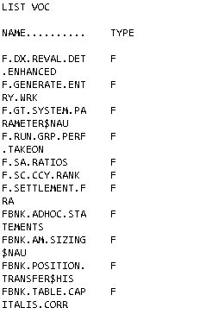
TAFC Environmental Variables
JEDIFILENAME_MD
jsh…>LIST VOC
Notes:
JEDIFILENAME_MD
Each jBASE account has a vocabulary file called the VOC file. The VOC file contains entries that identify every verb, sentence, paragraph, file, keyword, and menu that you can use while you are in a jBASE account. The command processor uses the VOC file to decide what action to take when you enter a command. The Voc (Vocabulary) file can also be called the MD, Master Dictionary. JEDIFILENAME_MD=$HOME/VOC
Sample Commands Pertaining To VOC
LIST VOC This will list all the entries in the Voc file
Q Quit process
Types Of VOC Entries
F File definition
K Keyword
M Menu Record
PA Paragraph
D Remote file pointer
S Sentence
V Verbs (commands)
JBS1. Introduction to jBASE Database-R11.01

Slide 18
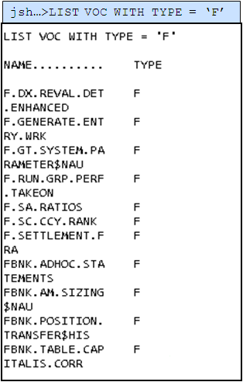
TAFC Environmental Variables
Notes:
LIST VOC WITH TYPE = ‘F’ can be used to see all the ‘File’ type Voc entries.
JBS1. Introduction to jBASE Database-R11.01

Slide 19
TAFC Environmental Variables
PA – Paragraph
  A paragraph is a series of sentences stored together under 1 name
jsh >JED VOC LOGIN
PA
EX
DATA TRAINEE01
DATA 123456
Notes:
Paragraph: A paragraph is a series of sentences stored together with one name.
Consider that you wish to create a script that will automatically launch EX program, provide the T24 User Name and Password and sign in. You can create a VOC entry of type PA as shown in the example.
Use the command JED VOC LOGIN, where JED is the command to invoke the JED editor, VOC is the file name and LOGIN is the name of the paragraph entry.
Line1: PA specifies that you are creating a paragraph entry
Line2: EX is the first sentence. This will launch the EX program
Line3: DATA INPUTT is the second sentence where DATA is a keyword and INPUTT (T24 sign on name)is the value.
Line3: DATA 123456 is the third sentence where DATA is a keyword and 123456 (Password for INPUTT) is the value.
JBS1. Introduction to jBASE Database-R11.01

Slide 20
TAFC Environmental Variables
JED VOC FBNK.CUSTOMER
F
../mbdemo.data/st/FBNK.CUST000
../mbdemo.dict/F.CUSTOMER]D
Notes:
File Pointers: A file pointer is used to point to files
Line1: JED VOC FBNK.CUSTOMER. JED is the command to invoke the JED editor. VOC is the name of the file and FBNK.CUSTOMER is the name of the file pointer.
Line2: F specifies that it is a file pointer
Line3: Path of the data file
Line4:Path of the dict file
You will learn about data files and dict files when you will learn about the file types available in jBASE
JBS1. Introduction to jBASE Database-R11.01

Slide 21
Workshop
List the VOC entries with the type ‘F’
Create a VOC entry that will enable you to logon to T24 from the ‘jsh’ prompt.
Notes:
List the VOC entries with the type ‘F’
Create a VOC entry that will enable you to logon to T24 from the ‘jsh’ prompt.
JBS1. Introduction to jBASE Database-R11.01

Slide 22
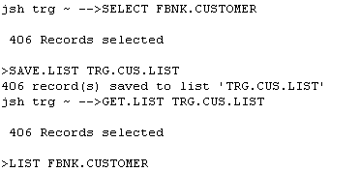
TAFC Environmental Variables
JBCLISTFILE – Contains the path of &SAVEDLISTS& directory
JBCEMULATE – Contains the emulation settings required by jBASE
Notes:
JBCLISTFILE
This is the environmental variable that contains the path of the &SAVEDLISTS& directory. When a SELECT statement is issued from the database prompt, the output of the SELECT statement can be saved using the SAVE.LIST command followed by the name of a file that is to store the selected ids. This file created by SAVE.LIST will get stored under the &SAVEDLISTS& directory and can be retrieved any time using the GET.LIST followed by the file name.
JBCLISTFILE=$HOME/&SAVEDLISTS&
Note: This variable can only be changed in the .profile file and not at the prompt.
JBCEMULATE
When clients want to shift from the current database to T24’s native - jBASE, set the environment variable JBCEMULATE. This variable contains the emulation settings required by jBASE. Temenos uses PRIME only.
JBS1. Introduction to jBASE Database-R11.01

Slide 23
Workshop
Save all customers who have sector set to 1000 on to a file named XXX.TRG.LIST where XXX is your name
Check the path where the file XXX.TRG.LIST has been created
Notes:
Save all customers who have sector set to 1000 on to a file named XXX.TRG.LIST where XXX is your name
Check the path where the file XXX.TRG.LIST has been created
JBS1. Introduction to jBASE Database-R11.01

Slide 24
TAFC Environmental Variables
Variables relating to error message suppression
  Due to programmatical errors, jBASE may throw errors at run time. These errors may appear when
    A value is divided by 0
    When a null variable is encountered
    When a numeric operation on a non-numeric value is encountered
  To suppress error messages that appear due the above, set the following variables to 1
    JBASE_ERRMSG_DIVIDE_ZERO=1
    JBASE_ERRMSG_ZERO_USED=1
    JBASE_ERRMSG_NON_NUMERIC=1
Notes:
There are environment variables available relating to error message suppression. The se variables, control the behaviour of run time error message handling for jBASE programs . By default jBASE will display all the error messages unless these variables are set.
1.1 Due to programatical errors, jBASE may throw errors at run time. These errors may appear when
1.1.1 A value is divided by 0
1.1.2 When a null variable is encountered
1.1.3 When a numeric operation on a non-numeric value is encountered
1.2 To suppress error messages that appear due the above, set the following variables to 1
1.2.1 JBASE_ERRMSG_DIVIDE_ZERO=1
1.2.2 JBASE_ERRMSG_ZERO_USED=1
1.2.3 JBASE_ERRMSG_NON_NUMERIC=1
Note : When setting the environment variable ensure that you don’t have a space between the variable and equating it to 1
export JBASE_ERRMSG_ZERO_USED=1 ( correct )
export JBASE_ERRMSG_ZERO_USED = 1 ( incorrect )
Care should be taken when using DIVIDE by ZERO variable because if set we might miss out on incorrect arithmetic calculations in the programs
These 3 variables supersede the JBASE_WARNLEVEL which was used until jBASE 4.0
JBS1. Introduction to jBASE Database-R11.01

Slide 25
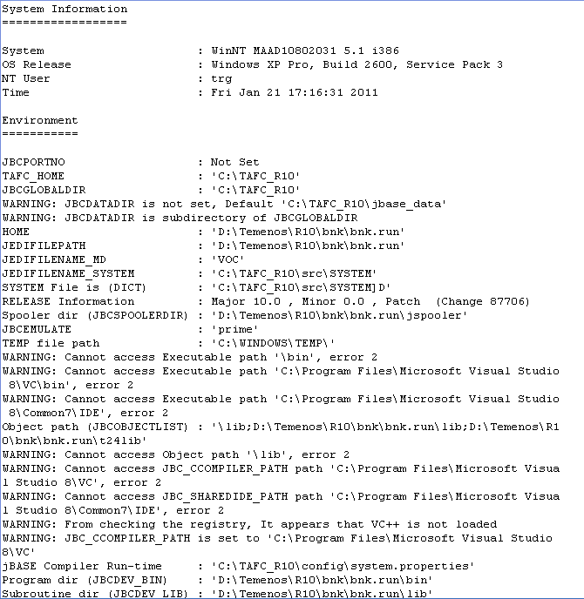
jdiag
jsh…>jdiag
Notes:
The jdiag utility is used to display information about your TAFC installation. It displays TAFC environment variables and its values. It is useful in pin-pointing problem areas of the setup.
JBS1. Introduction to jBASE Database-R11.01

Slide 26
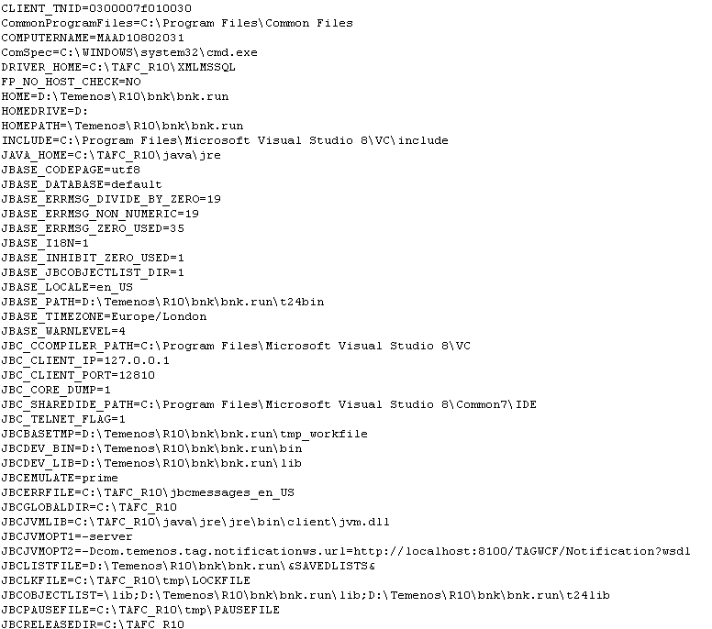
set
jsh…>set
Notes:
Use the set command to view the list of variables set
The above screen shot only contains a section of the variables. The ‘set’ command displays all variables set at the operating system level as well as at the jBASE level and hence the output would run to multiple pages.
JBS1. Introduction to jBASE Database-R11.01

Slide 27
Workshop
Execute the commands jdiag and set and view the output
Notes:
Execute the commands jdiag and set and view the output
JBS1. Introduction to jBASE Database-R11.01

Slide 28
Quiz – TRUE/FALSE
Only jBase commands can be executed from jsh prompt TRUE/FALSE
Assumption: No. of licenses available = 50 JBCPORTNO = 2001-2005 Q: Total number of users who can be online at the same time is 50 TRUE/FALSE
jspooler directory does not get installed automatically when you install jBase TRUE/FALSE
jBase can communicate with external databases TRUE/FALSE
PATH is a jBase specific environmental variable TRUE/FALSE
Notes:
FALSE
FALSE
TRUE
TRUE
FALSE
JBS1. Introduction to jBASE Database-R11.01

Slide 29
Quiz – Match The following
Environmental variables Purpose
1. JBCRELEASEDIR a. Contains the path to the config directory of TAFC
2. LIBPATH b. Holds the directory where TAFC has been installed
3. JBCLISTFILE c. Holds the path of the TAFC library files
4. JEDIFILENAME_MD d. Contains the path of the directory that is used to store select lists
5. JBCGLOBALDIR e. Holds the path of the VOC file
Slide <number>
Notes:
Holds the directory where TAFC has been installed (b)
Holds the path of the TAFC library files ( c )
Contains the path of the directory that is used to store select lists (d)
Holds the path of the VOC file (e)
Contains the path to the config directory of TAFC (a)
JBS1. Introduction to jBASE Database-R11.01

Slide 30
Summary
In this learning unit, you learnt about the basics of jBASE
You will now be able to
Explain what is jBASE
Analyze a simple T24 Architecture
Analyze jBASE directory structure
State the purpose of the .profile/remote.cmd file
Analyze jBASE environment variables
JBCRELEASEDIR, JBCPORTNO, JBCGLOBALDIR, PATH, LIBPATH, JBCSPOOLERDIR, JEDIFILENAME_MD, JBCLISTFILE, JBCEMULATE, JBASE_ERRMSG_DIVIDE_ZERO, JBASE_ERRMSG_ZERO_USED, JBASE_ERRMSG_NON_NUMERIC
Slide <number>
Notes:
In this learning unit, you learnt about the basics of jBASE
You will now be able to
Explain what is jBASE
Analyze a simple T24 Architecture
Analyze jBASE directory structure
State the purpose of the .profile/remote.cmd file
Analyze jBASE environment variables
JBCRELEASEDIR, JBCPORTNO, JBCGLOBALDIR, PATH, LIBPATH, JBCSPOOLERDIR, JEDIFILENAME_MD, JBCLISTFILE, JBCEMULATE, JBASE_ERRMSG_DIVIDE_ZERO, JBASE_ERRMSG_ZERO_USED, JBASE_ERRMSG_NON_NUMERIC
JBS1. Introduction to jBASE Database-R11.01

Slide 31


www.capgemini.com/financialservices
Thank you
Notes:
© 2006 Capgemini - All rights reserved

